Slide 1
Plastinction Global Plastic Pollution Trends
Courtney Kennedy

Slide 2
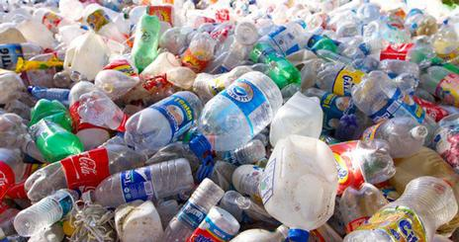
What is plastic pollution like in 2020 and how has it changed from 2019 to 2020?

Slide 3

Break Free From Plastic Brand Audit
#1
Polyester (PET) → Polyester fibers and beverage bottles
for water and soda
High Density Polyethylene (HDPE) →Plastic milk
containers, plastic bags, bottle caps
#2
PVC → Fast Food Toys, Window frames, bottles for chemicals, flooring, plumbing pipes
#3
A total of 775,725 pieces of plastic waste were collected in 2019 and 2020 and 39.64% were marked with clear consumer brand. The collections occurred in 65 out of 195 countries.
Low Density Polyethylene (LDPE) → Plastic bags, Ziploc bags, buckets, squeeze bottles, plastic tubes, chopping boards
#4
Polypropylene (PP) → Flower pots, bumpers, carry-out beverage cups, bottle caps and surgical face masks
#5
Polystyrene (PS) → Toys, Styrofoam, beverage/food
coolers, beer and wine cups, carry-out food containers
#6
Other (O) → Bioplastics, sachets (ketchup packets),
cigarette butts
#7

Slide 4
Plastic Pollution in 2020

Slide 5
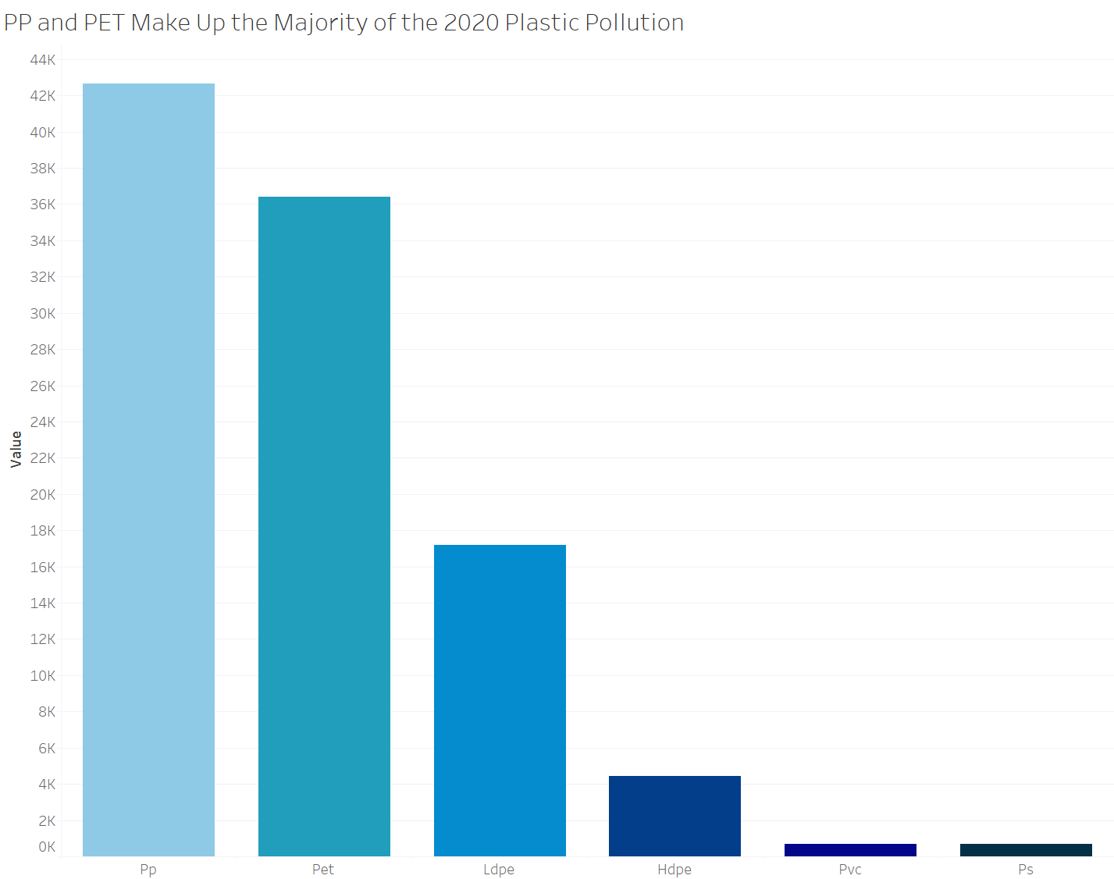
Glimpse into Global Plastic Pollution in 2020
346,494 pieces of plastic collected
PP & PET
plastic pollution are the most common
Countries with the most plastic in 2020
Nigeria
Philippines
Switzerland

Slide 6
Plastic Type Trends

Slide 7
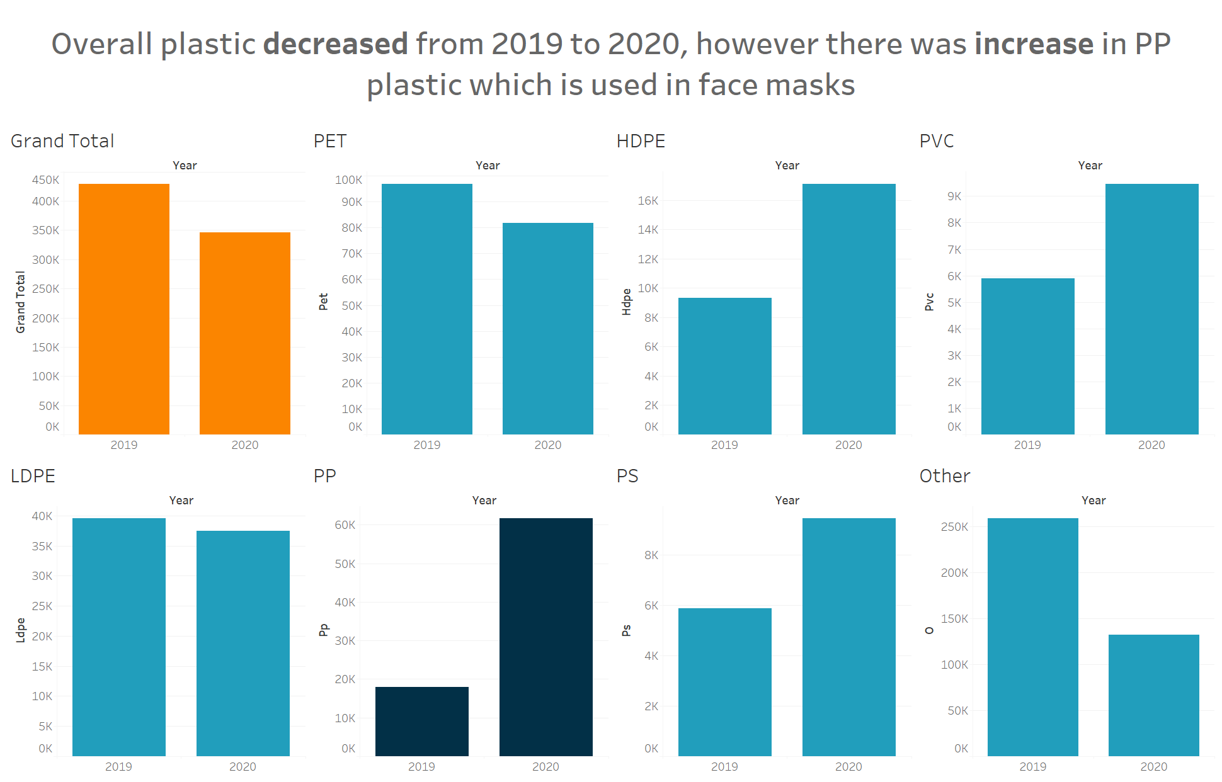
7

Slide 8
Brands With the Most Collected Plastic

Slide 9
Top Plastic Pollution Brands 2019
1
The Coca-Cola Company
2
Pure Water, Inc.
3
Nestle
4
PepsiCo
5
Universal Robina Corporation
6
Unilever
7
Inconnu
8
Philip Morris International
9
Reckitt Benckiser
10
Sahakari Jal

Slide 10
Top Plastic Pollution Brands 2020
1
The Coca-Cola Company
2
Nestle
3
Universal Robina Corporation
4
Colgate-Palmolive
5
Unilever
6
PepsiCo
7
Mayora Indah
8
Tamil Nadu Co-Operative
9
Proctor & Gamble
10
Philip Morris International

Slide 11
Top Plastic Pollution Brands Overall
1
The Coca-Cola Company
2
Nestle
3
Universal Robina Corporation
4
PepsiCo
5
Unilever
6
Colgate-Palmolive
7
Pure Water, Inc.
8
Philip Morris International
9
Proctor & Gamble
10
Mayora Indah

Slide 12
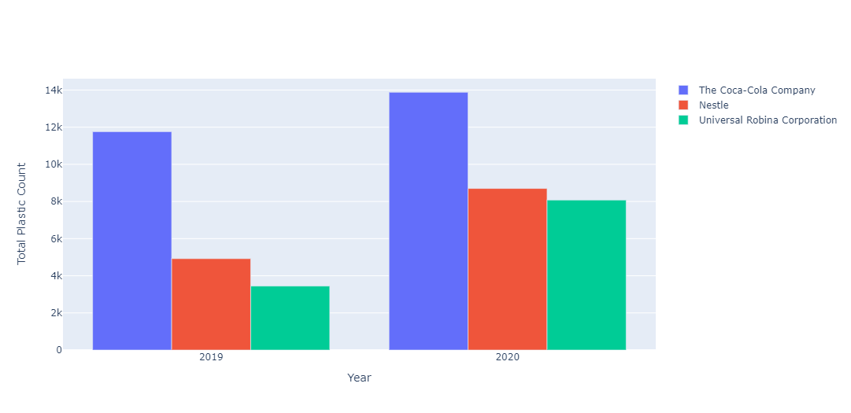
Top Plastic Pollution Brands Saw An Increase of Plastic from 2019 to 2020

Slide 13
Global Distribution of Plastic

Slide 14
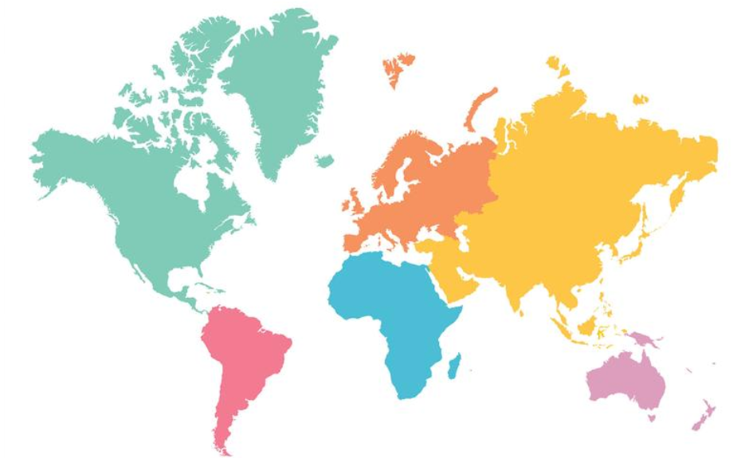
Asia and Africa Make Up Majority of the Global Distribution of Plastic in 2020 and 2019
Europe
8.95%
North America
2.05%
Asia
41.67%
Africa
44.10%
South America
2.98%
Oceania
0.25%

Slide 15
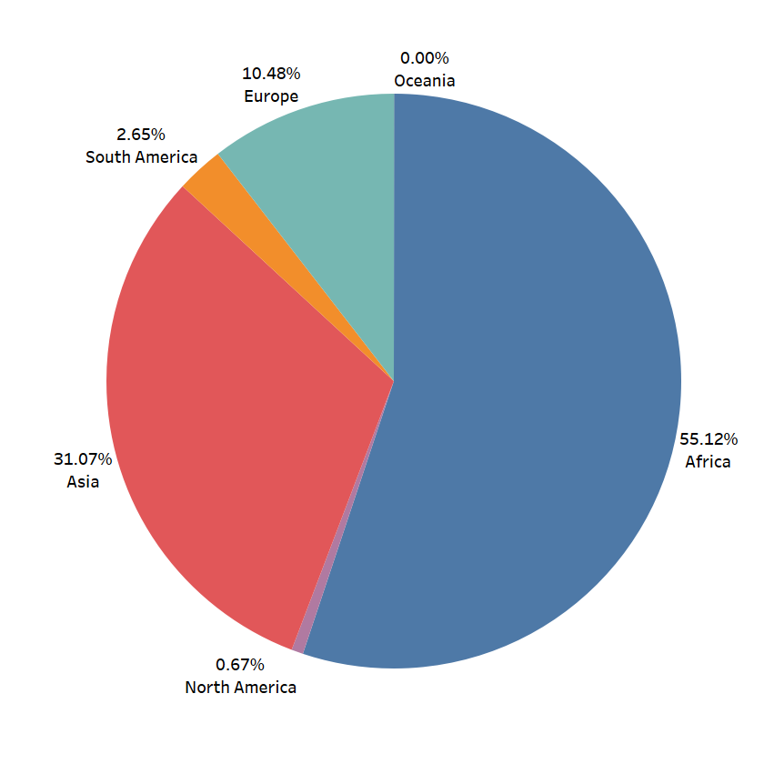
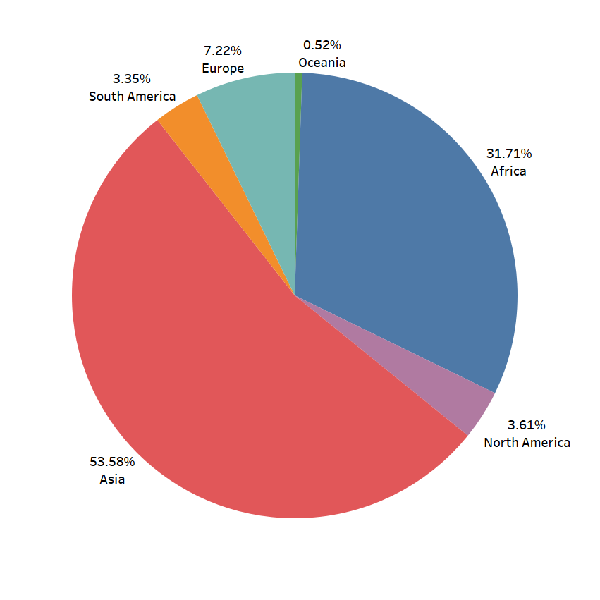
Majority of the Global Distribution of Plastic Shifts from Africa in 2019 to Asia in 2020
2019 Percent of Total World Plastic
2020 Percent of Total World Plastic

Slide 16
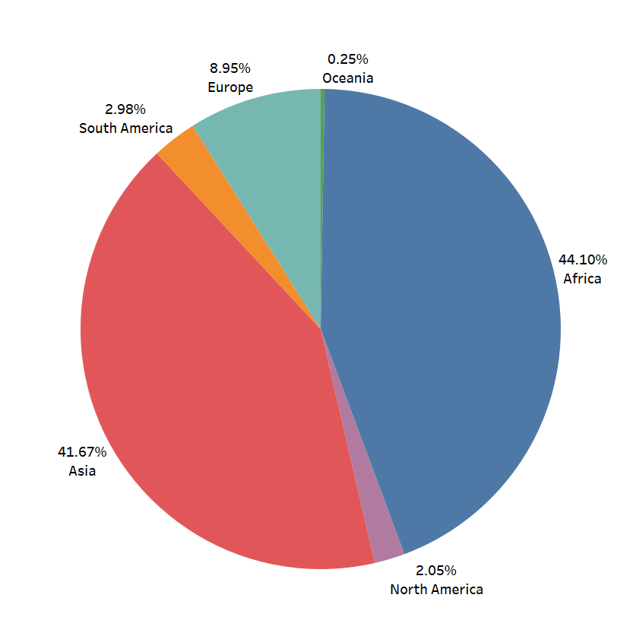
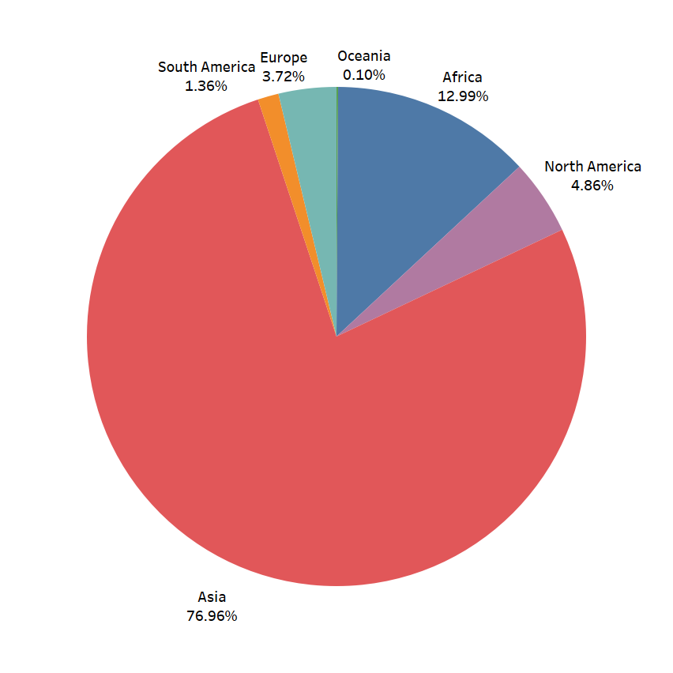
Where the majority of volunteers are located correlates to where the majority of the plastic is: Asia and Africa
Percent of Total World Plastic
Percent of Total Volunteers

Slide 17
Takeaways

Slide 18
Plastic Pollution Trends Have Changed from 2019 to 2020
COVID-19 caused increase in disposable masks which resulted in increase of PP plastic in 2020
Plastic pollution is declining overall, but the top plastic pollution companies are increasing plastic pollution
The Coca-Cola Company, Nestle, and Universal Robino Corporation have the most plastic pollution
Shift from top plastic continent being Africa in 2019 to Asia in 2020

Slide 19
Action to Take
Top Plastic Producing Companies
Masks
Asia and Africa
Lobby to require big plastic producers to reduce plastic being produced and to create zero waste options
Advocate and invest in improved infrastructure and waste management in Africa and Asia
Invest in R&D for non-plastic masks and for mask recycling

Slide 20
Future Work
Normalizing country plastic collection values by taking into account the number of volunteers
Standardizing collection process (select from list of brands and countries etc. rather than typing plastic information)
Taking into account the recyclability of the types of plastic in rankings
Incorporating other plastic pollution counts for countries not in the data set

Slide 21
Questions?

Slide 22
Appendix
Country Rankings
2019
Taiwan
Nigeria
Philippines
Indonesia
Ecuador
2020
Nigeria
Philippines
Switzerland
India
USA

Slide 23
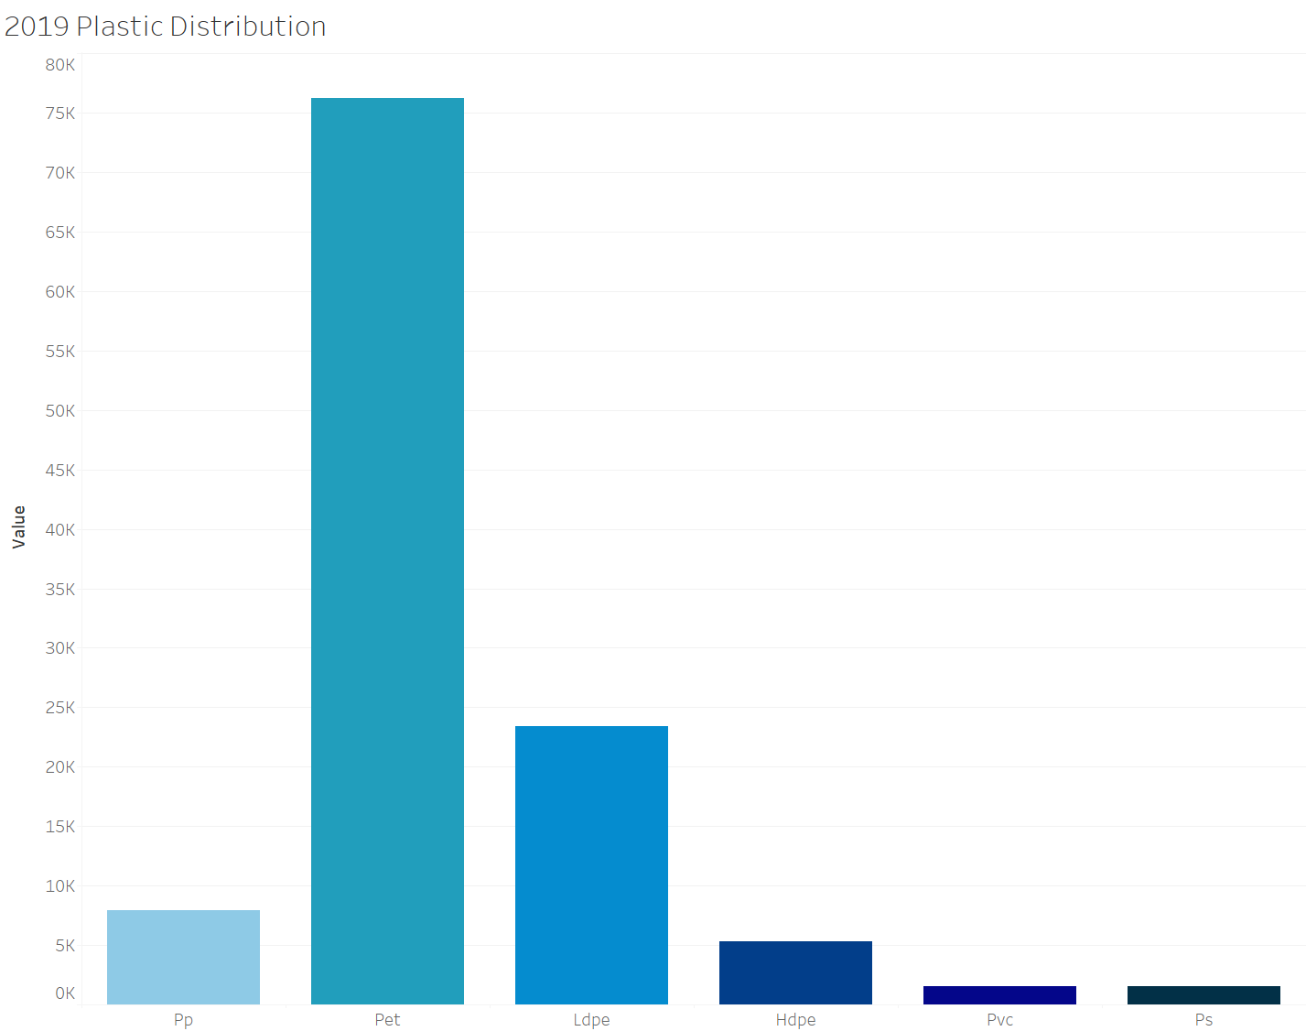

Slide 24
Variables
country character Country of cleanup
year double Year (2019 or 2020)
parent_company character Source of plastic
empty double Category left empty count
hdpe double High density polyethylene count (Plastic milk containers, plastic bags, bottle caps, trash cans, oil cans, plastic lumber, toolboxes, supplement containers)
ldpe double Low density polyethylene count (Plastic bags, Ziploc bags, buckets, squeeze bottles, plastic tubes, chopping boards)
o double Category marked other count
pet double Polyester plastic count (Polyester fibers, soft drink bottles, food containers (also see plastic bottles)
pp double Polypropylene count (Flower pots, bumpers, car interior trim, industrial fibers, carry-out beverage cups, microwavable food containers, DVD keep cases)
ps double Polystyrene count (Toys, video cassettes, ashtrays, trunks, beverage/food coolers, beer cups, wine and champagne cups, carry-out food containers, Styrofoam)
pvc double PVC plastic count (Window frames, bottles for chemicals, flooring, plumbing pipes)
grand_total double Grand total count (all types of plastic)
num_events double Number of counting events
volunteers double Number of volunteers

Slide 25
Note on top companies
La Doo and Barna
Parent company brand in Nigeria
Not real company
Both in top plastic producing companies but chose to remove

